Slide 1
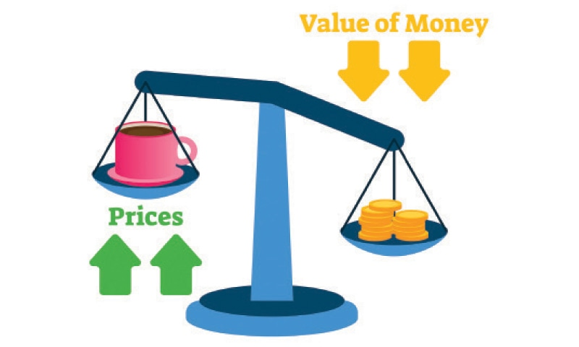
Inflation
Inflation is commonly understood as a situation of substantial, and general increase in the level of prices of goods and services in an economy and a consequent fall in the value of money over a period of time.
When the general price level rises, value of money falls and as such each unit of currency buys fewer goods and services. Consequently, inflation reflects a reduction in the purchasing power per unit of money.

Slide 2
Causes of inflation
1. The Government Prints TOO MUCH Money (The Quantity Theory)
Governments that keep printing money to pay debts end up with hyperinflation.
There are more “rich” people but the same amount of products.
Result: Banks refuse to lend and GDP falls
Examples:
Bolivia, Peru, Brazil
Germany after WWI
What would happen if the government printed money to pay off the national debt all at once?

Slide 3
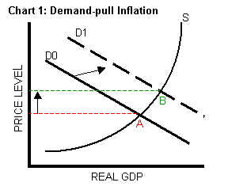
2. DEMAND-PULL INFLATION
DEMAND PULLS UP PRICES!!!
Demand increases but supply stays the same. What is the result?
A Shortage driving prices up
An overheated economy with excessive spending but same amount of goods.

Slide 4
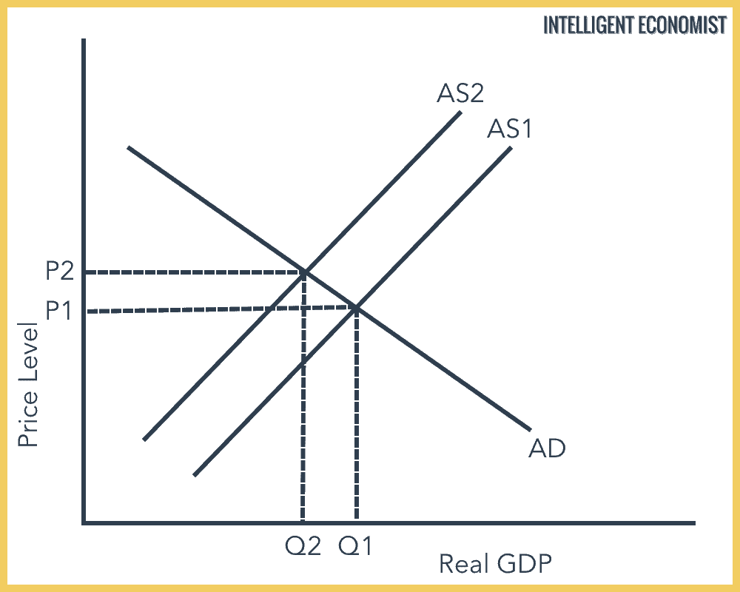
3. COST-PUSH INFLATION
Higher production costs increase prices
A negative supply shock increases the costs of production
and forces producers to increase prices.
Examples:
Hurricane Katrina destroyed oil refineries and causes gas prices to go up. Companies that use gas increase their prices.

Slide 5
The Wage-Price Spiral
A Perpetual Process:
1.Workers demand raises
2.Owners increase prices to pay for raises
3. High prices cause workers to demand higher raises
4. Owners increase prices to pay for higher raises
5. High prices cause workers to demand higher raises
6. Owners increase prices to pay for higher raises

Slide 6
Types of inflation
Creeping inflation:-The inflation of a nation increases gradually, but continuously, over time.
Walking Inflation: -When the price rise is moderate. It is a warning signal for the government to control it before it turns into running inflation.
Running inflation:- A rapid acceleration in the rate of rising prices more than 10% per annum is referred as Running Inflation.
Galloping inflation:-Prices rise by double or triple digit inflation rates like 20% ,100% or 200% per annum.
Hyperinflation :-It is a stage of very high rate of inflation. While economies seem to survive under galloping inflation, a third and deadly strain takes hold when the cancer of hyperinflation strikes. Hyperinflation occurs when the prices go out of control and the monetary authorities are unable to impose any check on it. Germany had witnessed hyperinflation in 1920’s.

Slide 7
Deflation:-Deflation is the reverse of inflation. It refers to a sustained decline in the price level of goods and services. It occurs when the annual inflation rate falls below zero percent (a negative inflation rate), resulting in an increase in the real value of money. Japan suffered from deflation for almost a decade in 1990s.
Stagflation:-Stagflation is an economic condition when stagnant economic growth, high unemployment, and high inflation combine together. Basically, inflation plus stagnant growth equals stagflation. The term emerged during the 1973-1975 recession.

Slide 8
Measures of inflation
Wholesale price index (WPI) measures and tracks the changes in the price of goods before they reach consumers: goods that are sold in bulk and traded between entities or businesses (rather than consumers). A WPI typically takes into account commodity prices, but the products included vary from country to country. They are also subject to change, as needed, to better reflect the current economy.
Consumer Price Index (CPI) is a measure that examines the weighted average of prices of a basket of consumer goods and services, such as transportation, food, and medical care. It is calculated by taking price changes for each item in the predetermined basket of goods and averaging them. Changes in the CPI are used to assess price changes associated with the cost of living.
RBI used WPI for most of its policy decisions before 2014. Thereafter, as part of the reforms, RBI shifted to CPI for policy decisions.
In March 2015, Reserve Bank of India (RBI) officially adopted inflation targeting as the monetary policy framework for the Indian economy under which RBI targets to keep Consumer Price Index (CPI) inflation at 4% (+/-2%).

Slide 9
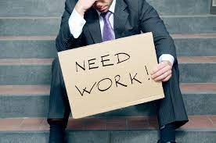
Unemployment
Types
Calculating Rates
Implications

Slide 10
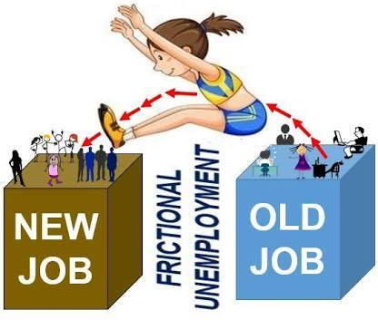
Types of unemployment
Frictional Unemployment: When people take time to find a job.
Example: When someone is laid off, changes jobs, or need time to find a job after graduating from school.

Slide 11
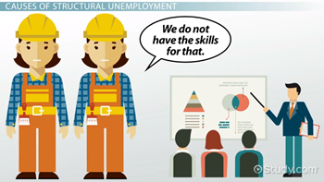
Structural Unemployment: When workers’ skills do not match what jobs are available for (structure of) the current economy.
Causes of Structural Unemployment:
New Technology
New Resources
Changes in Consumer Demand
Globalization- Shift to foreign markets
Lack of Education

Slide 12
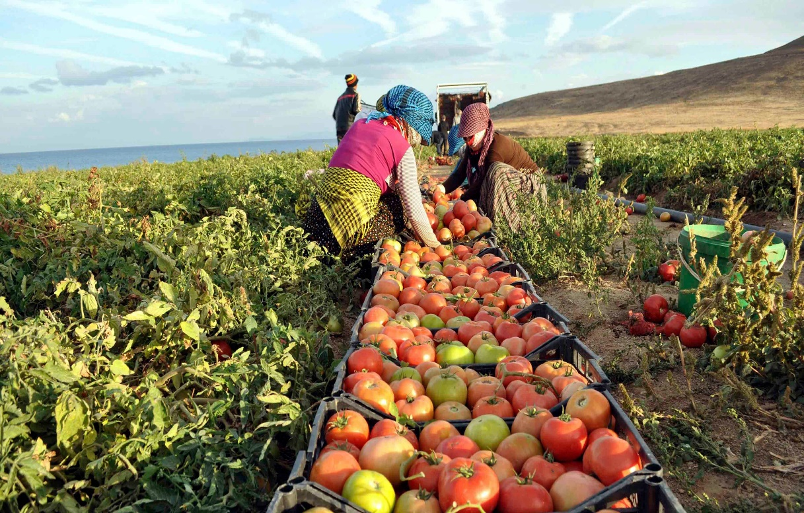
Seasonal Unemployment: When industries slow or shut down for a season of the year to make seasonal shifts in production schedules and people lose their jobs.
Examples: When people who sell Halloween costumes or Christmas trees are out of a job because the holiday has passed.

Slide 13
Cyclical Unemployment: Unemployment that goes up during times of economic turmoil, and goes down during times of economic prosperity.
Examples: A recession causes people to save more and spend less, because of this companies may slow down production and lay off workers.

Slide 14
The unemployment rate
The Unemployment Rate is the percentage of a nation’s labor force that is unemployed.
The Labor Force is NOT every citizen.
The Labor Force is made up of individuals 16 and older who either have a job or are actively seeking for a job.
The Unemployment Rate is adjusted to account for seasonal unemployment so that it is more accurately reflective of the health of the economy.

Slide 15
Labour Force
The labour force is the number of employed people plus the unemployed who are looking for work. The labour pool does not include the jobless who aren't looking for a job.
For example, stay-at-home moms, retirees, and students are not part of the labour force. Discouraged workers who would like a job but have given up looking are not in the labour force either.
To be considered part of the labour force, you must be available, willing to work, and have recently looked for a job. The official unemployment rate measures the jobless who are still in the labour force.

Slide 16
Labour Force Participation Rate
The labour force participation rate estimates an economy’s active workforce.
The formula is the number of people ages 16 and older who are employed or actively seeking employment, divided by the total non-institutionalized, civilian working-age population.
Formula= Labour Force/Total Eligible Population
The labour force participation rate indicates the percentage of all working-age people employed or actively seeking work.
In conjunction with the unemployment numbers, it can offer some perspective into the state of the economy.
The rate varies over time based on social, demographic, and economic trends.
Global labour force participation has shown a steady decline since 1990.

Slide 17
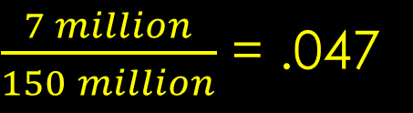
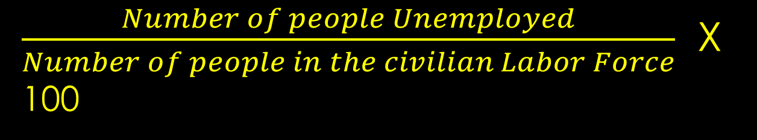
Calculating the unemployment rate
To find the Unemployment Rate, we use the following equation:
For Example, if there are 7 million unemployed people. And there are 150 million people in the civilian labor force, we have the following rate of Unemployment:
$\frac{Number of people Unemployed}{Number of people in the civilian Labor Force}$ X 100
$\frac{7 million}{150 million}$ = .047
$$.047 X 100=4.7\% Unemployment$$

Slide 18
Goal: Full employment
Zero Unemployment is always impossible in a market economy.
But we strive for Full Employment where no cyclical unemployment exists in the economy.
An unemployment rate of about 4-6 percent is normal during full employment.

Slide 19
Aspects of full employment
Full Employment means everyone who wants a job has a job.
But some of those people may be Underemployed meaning they are working at a job below their skillset.
Example: An individual with a Master’s degree, unable to find work in their field, and settling for a job of a cab driver.

Slide 20
Thank you…

